Slide 1
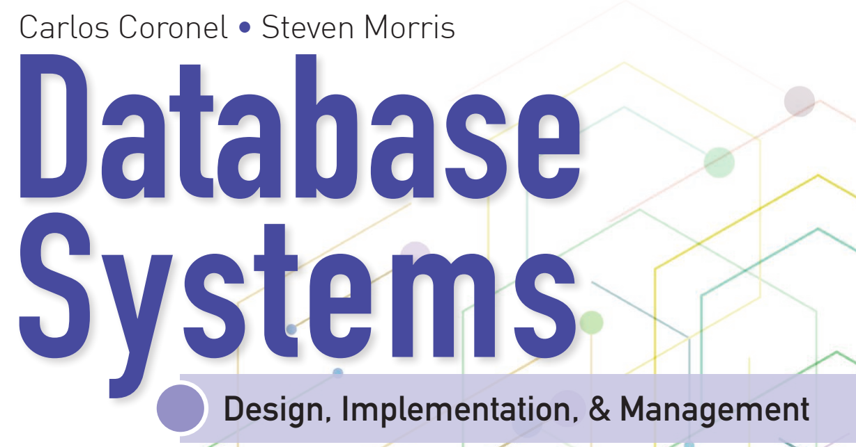
Learning Objectives
Define the difference between data and information
Describe what a database is, the various types of databases, and why they are valuable assets for decision making
Explain the importance of database design
Outline how modern databases evolved from file systems
Identify flaws in file system data management
Outline the main components of the database system
Describe the main functions of a database management system (DBMS)

Slide 2


National Economics University Faculty of Data Science & Artificial Intelligence
Database System Design, Implementation And Management Course – Advanced SQL
Instructor: Duc Minh Vu (FDA – SLSCM Lab)
Email: minhvd [at] neu.edu.vn
12/19/2024
Database System Design, Implementation And Management
2

Slide 3
Learning Objectives
8-1 Use SQL to create a table manually
8-2 Use SQL to create a copy of a table using a subquery
8-3 Manipulate the structure of existing tables to add, modify, and remove columns and constraints
8-4 Use SQL to do data manipulation (insert, update, and deleterows of data)
8-5 Use SQL to create database views, including updatable views
8-6 Use procedural SQL to create triggers, stored procedures, and procedural SQL functions
8-7 Create embedded SQL

Slide 4
8-1 Data Definition Commands

Slide 5
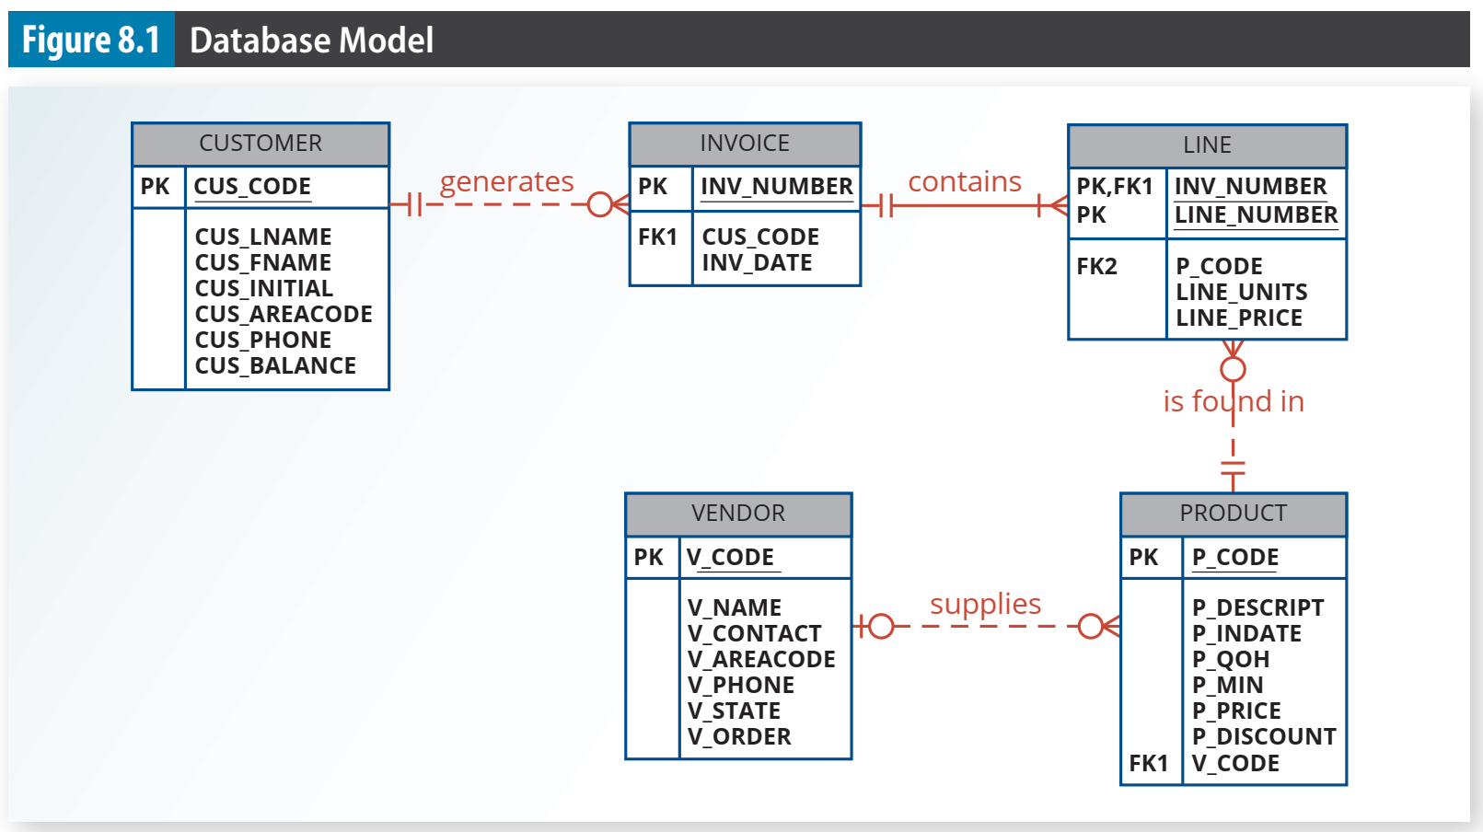

Slide 6
8-1b Creating the Database
If you are using an enterprise RDBMS, you must be authenticated by the RDBMS before you can start creating tables.
Authentication The process through which a DBMS verifies that only registered users can access the database.
To be authenticated, you must log on to the RDBMS using a user ID and a password created by the database administrator.
In an enterprise RDBMS, every user ID is associated with a database schema.

Slide 7
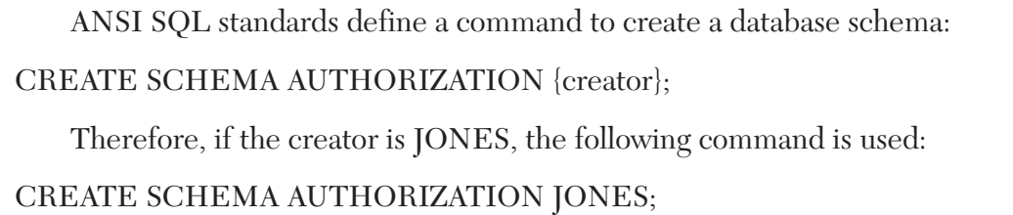
8-1c The Database Schema
a schema is a logical group of database objects—such as tables and indexes—that are related to each other
the schema belongs to a single user or application
A single database can hold multiple schemas that belong to different users or applications.
Schemas are useful in that they group tables by owner (or function) and enforce a first level of security by allowing each user to see only the tables that belong to that user

Slide 8
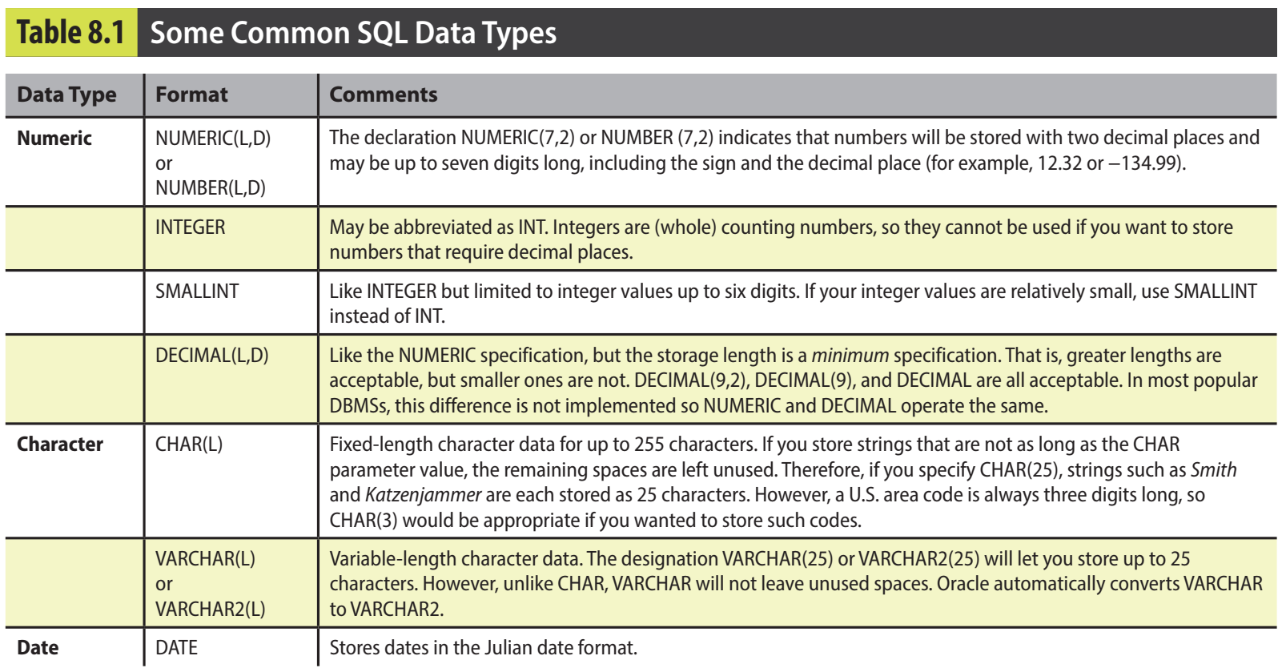
8-1d Data Types

Slide 9
8-2 Creating Table Structures

Slide 10
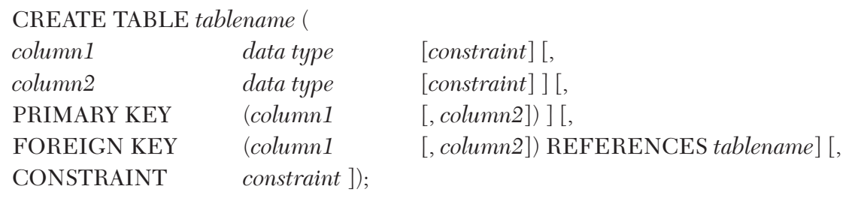
8-2a CREATE TABLE command
CREATE TABLE A SQL command that creates a table’s structures using the characteristics and attributes given.

Slide 11
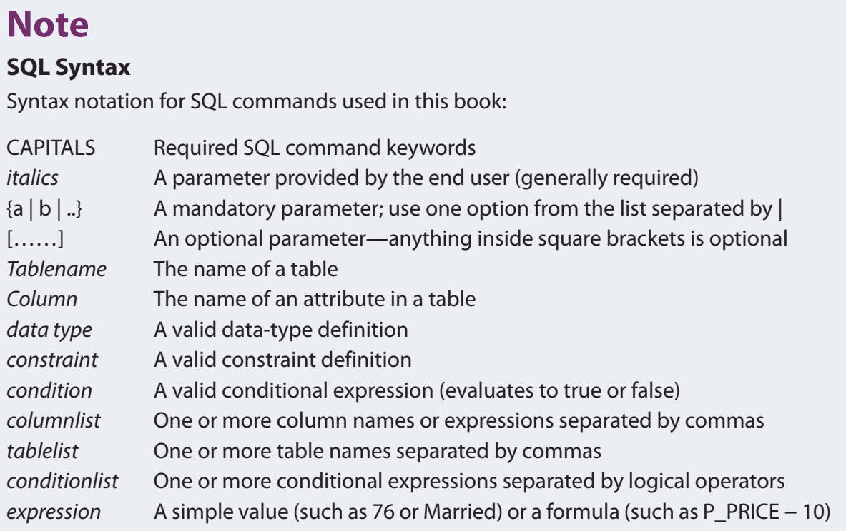

Slide 12
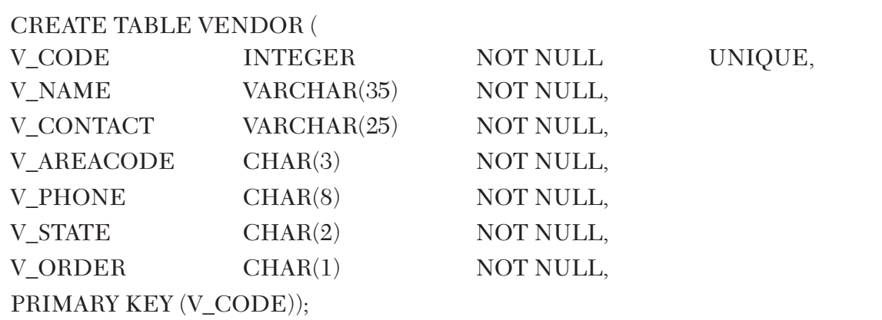

Slide 13
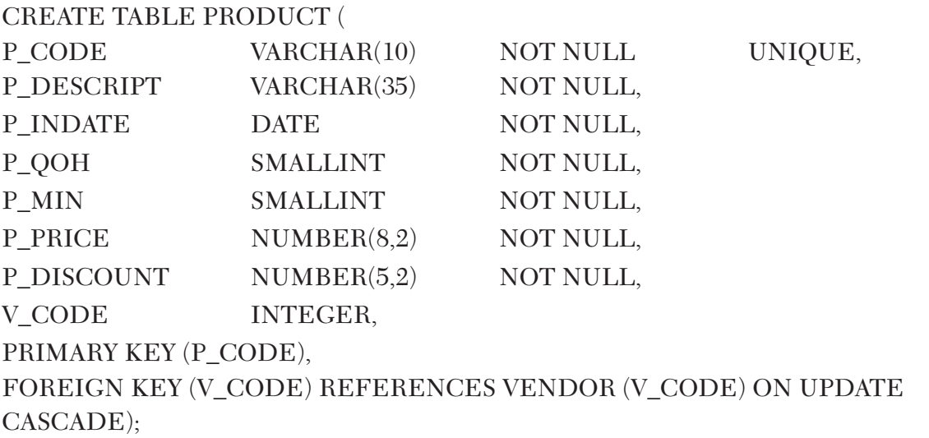

Slide 14
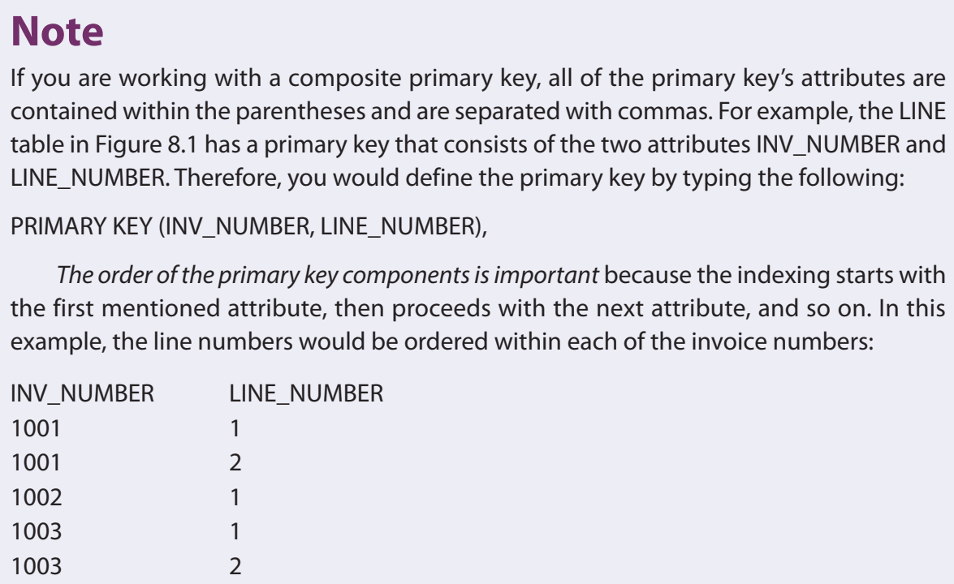

Slide 15
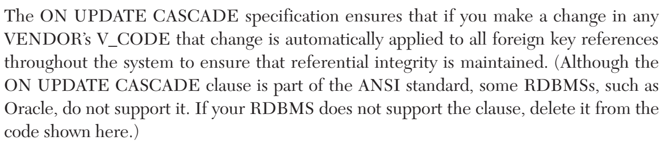

Slide 16
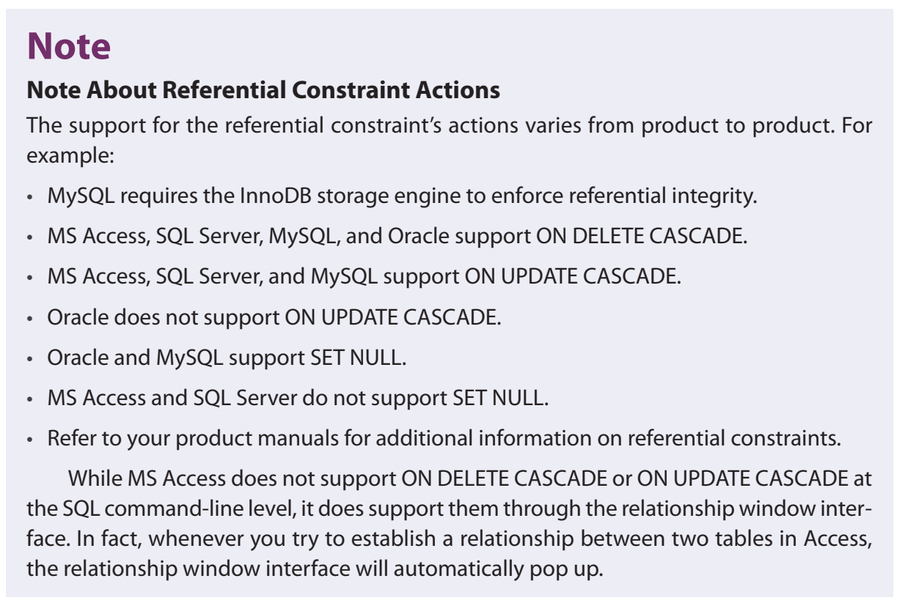

Slide 17
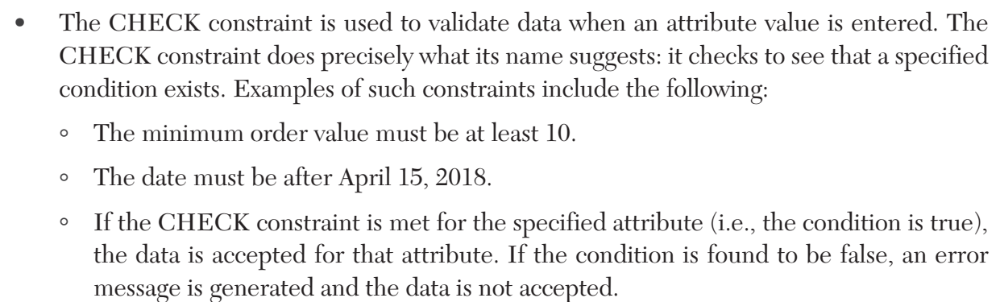

Slide 18
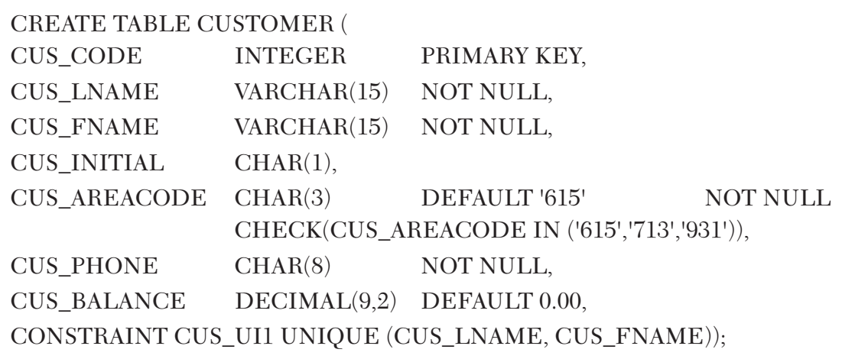

Slide 19
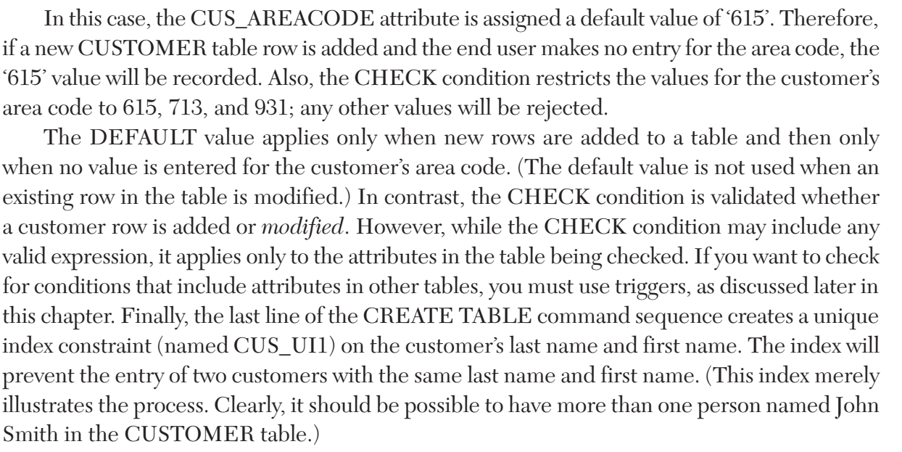

Slide 20
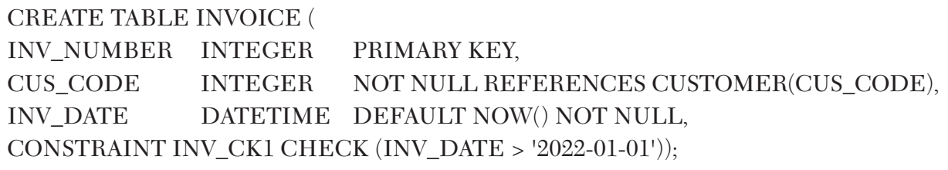

Slide 21
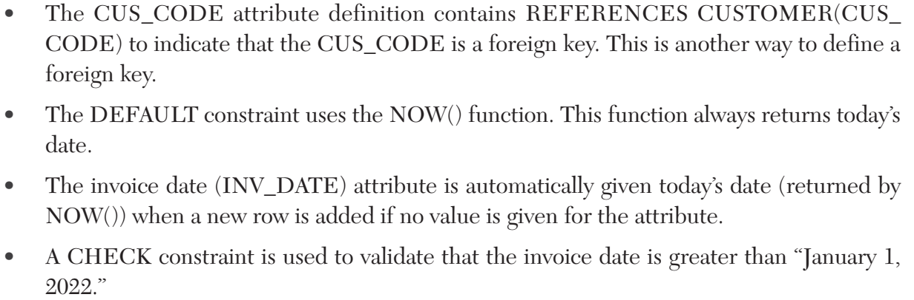

Slide 22
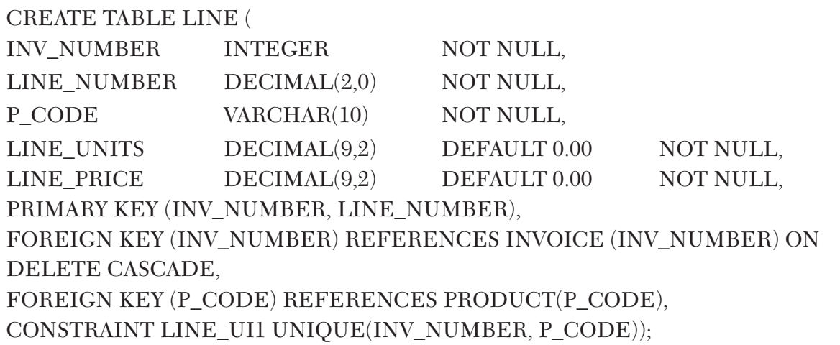

Slide 23
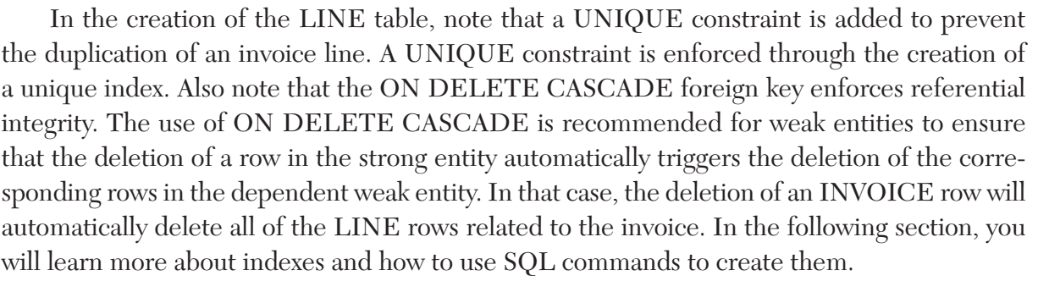

Slide 24
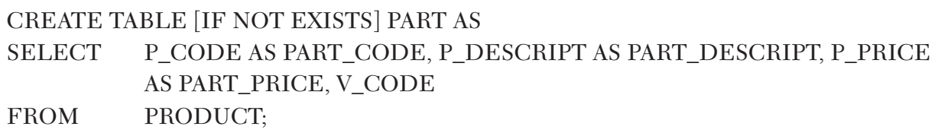
8-2c Creating a Table with a SELECT Statement
SQL provides a way to rapidly create a new table based on selected columns and rows of an existing table using a subquery.

Slide 25
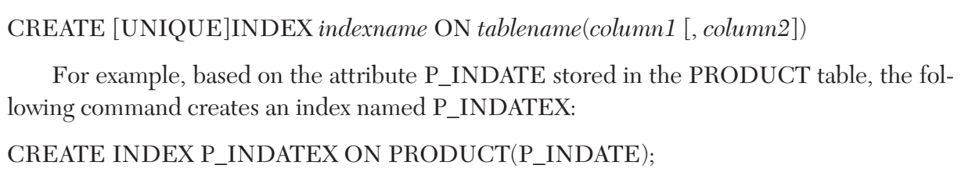
8-2d SQL Indexes
CREATE INDEX A SQL command that creates indexes on the basis of a selected attribute or attributes
indexes can be used to improve the efficiency of searches and to avoid duplicate column values
when you declare a primary key, the DBMS automatically creates a unique index
Using the CREATE INDEX command, SQL indexes can be created on the basis of any selected attribute.

Slide 26
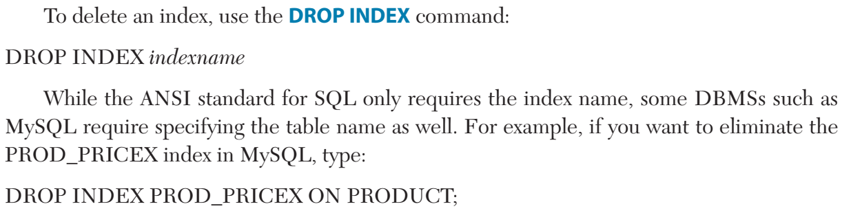
8-2d SQL Indexes
DROP INDEX A SQL command used to delete database objects such as tables, views, indexes, and users.

Slide 27
8-3 Altering Table Structures

Slide 28

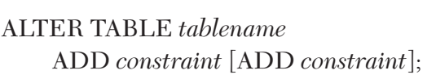
8-3 Altering Table Structures
ALTER TABLE The SQL command used to make changes to table structure. When the command is followed by a keyword (ADD, ALTER, or MODIFY), it adds a column or changes column characteristics.

Slide 29






Slide 30
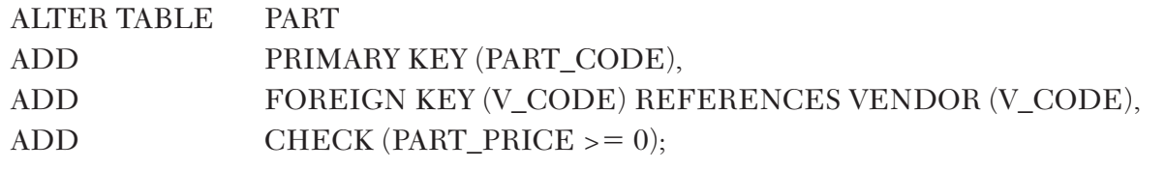
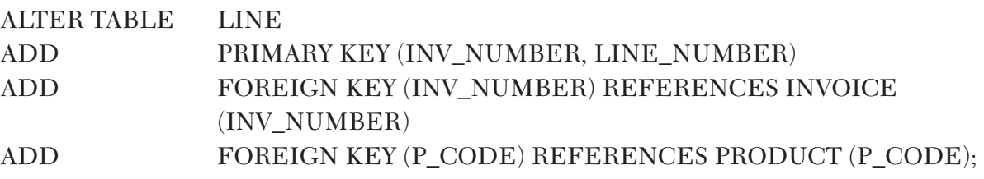



Slide 31
8-4 Data Manipulation Commands

Slide 32
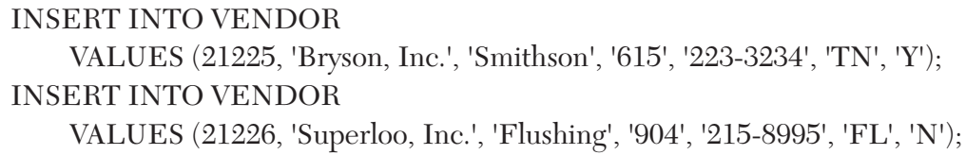
8-4a Adding Table Rows
INSERT INTO tablename VALUES (value1, value2, …, valuen)

Slide 33
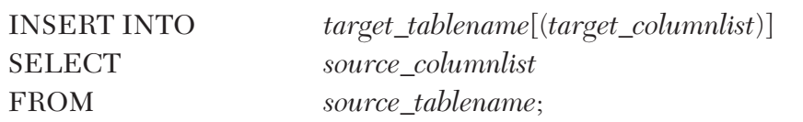
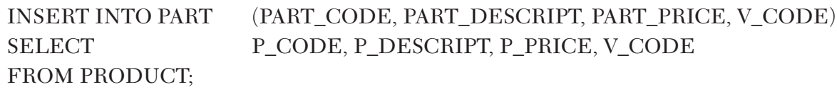
8-4b Inserting Table Rows with a SELECT Subquery

Slide 34
8-4c Saving Table Changes
COMMIT The SQL command that terminates a transaction by permanently saving data changes to a database.
The COMMIT command permanently saves all changes—such as rows added, attributes modified, and rows deleted—made to any table in the database
COMMIT [WORK | TRANSACTION]

Slide 35
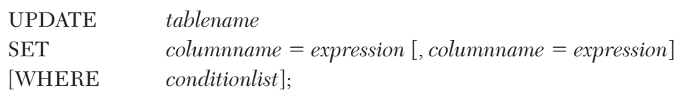
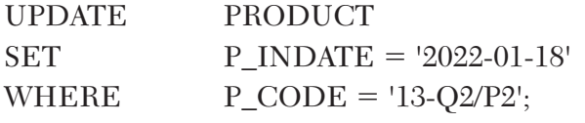
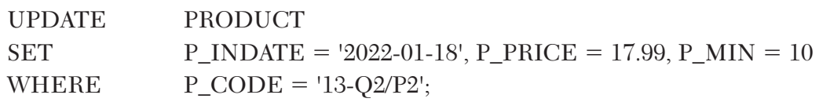
8-4d Updating Table Rows
UPDATE A SQL command that allows attribute values to be changed in one or more rows of a table.

Slide 36


8-4e Deleting Table Rows
DELETE A SQL command that allows data rows to be deleted from a table.

Slide 37
8-4f Restoring Table Contents
ROLLBACK A SQL command that restores the database table contents to the condition that existed after the last COMMIT statement.
ROLLBACK;
If you have not yet used the COMMIT command to store the changes permanently in the database, you can restore the database to its previous condition with the ROLLBACK command.
COMMIT and ROLLBACK work only with data manipulation commands that add, modify, or delete table rows

Slide 38
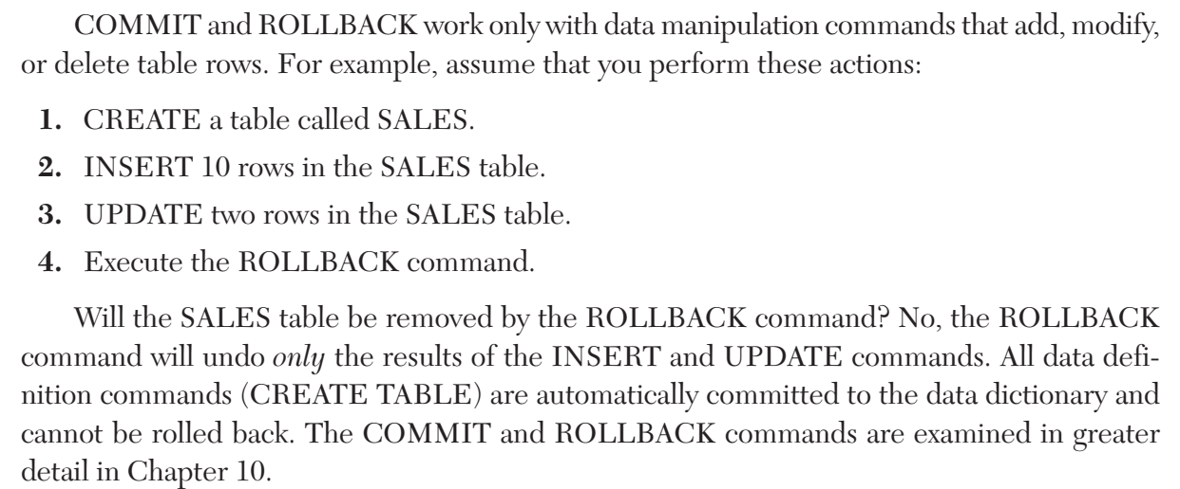

Slide 39
8-5 Virtual Tables: Creating a View

Slide 40
8-5 Virtual Tables: Creating a View
View A virtual table based on a SELECT query that is saved as an object in the database.
base table The table on which a view is based.
CREATE VIEW A SQL command that creates a logical, “virtual” table. The view can be treated as a real table.
CREATE VIEW viewname [(column list)] AS SELECT query

Slide 41
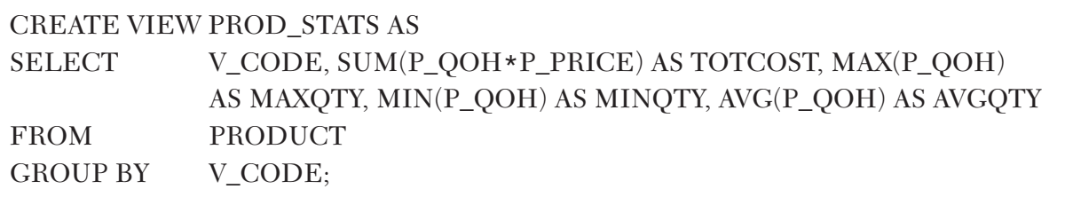

Slide 42
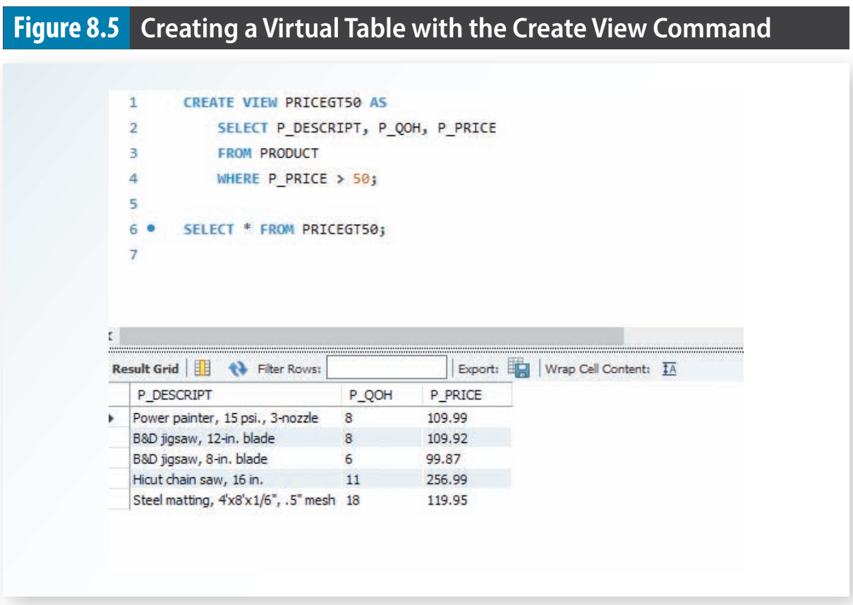

Slide 43
8-6 Auto Increment, Identity, and Sequences

Slide 44
8-7 Procedural SQL

Slide 45
8-7 Procedural SQL
persistent storage module (PSM) A block of code with standard SQL statements and procedural extensions that is stored and executed at the DBMS server.
The PSM represents business logic that can be encapsulated, stored, and shared among multiple database users.
A PSM lets an administrator assign specific access rights to a stored module to ensure that only authorized users can use it.
Procedural SQL An extension of the SQL programming language, such as PL/SQL or TSQL, that add procedural programming capabilities, such as variable and logical flow control, to SQL and is designed to run inside the database.

Slide 46
8-7a Stored Procedures
stored procedure (1) A named collection of procedural and SQL statements
They can be used to encapsulate and represent business transactions
Stored procedures substantially reduce network traffic and increase performance.
Stored procedures help reduce code duplication by means of code isolation and code sharing (creating unique modules that are called by application programs)

Slide 47
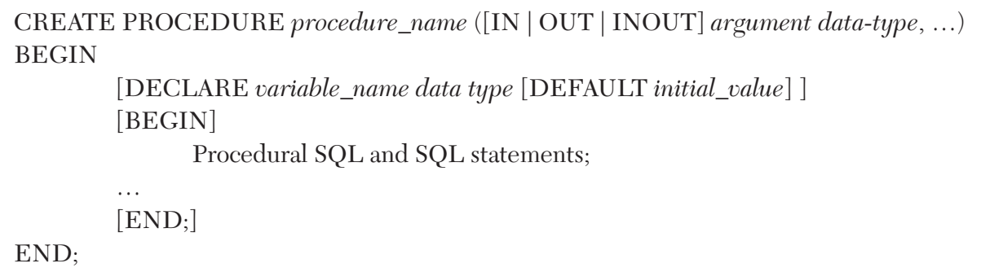

Slide 48
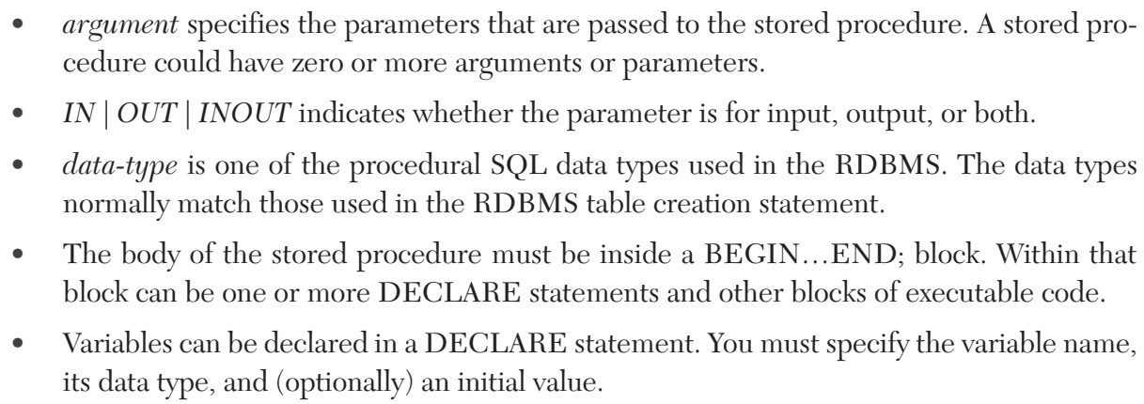

Slide 49
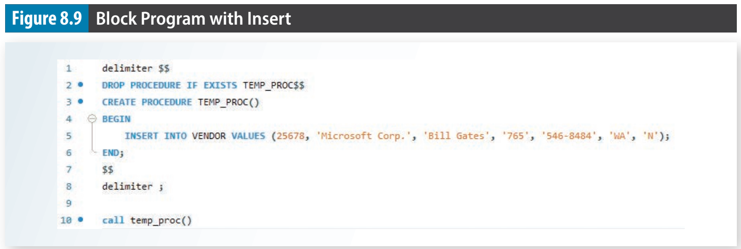

Slide 50
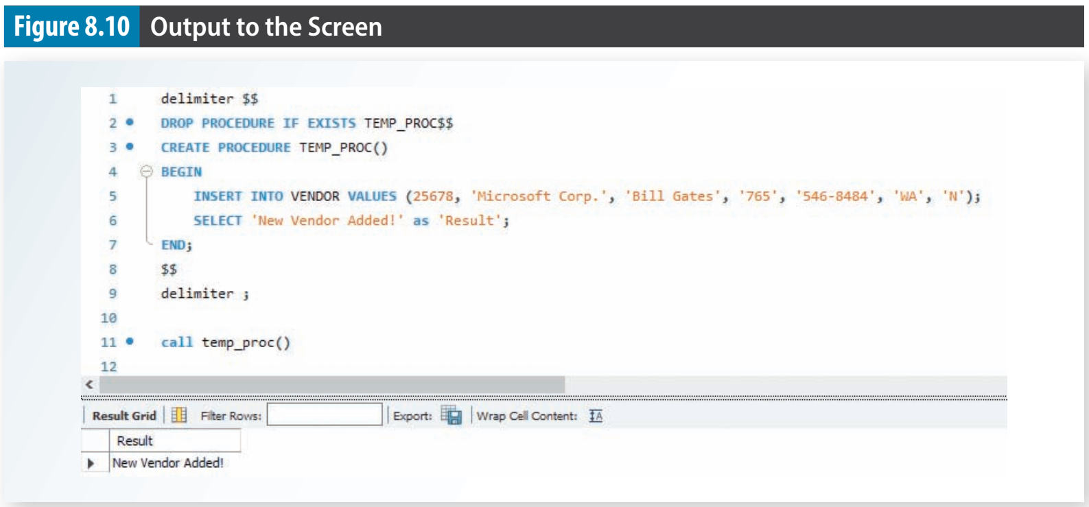

Slide 51
8-7b Working with Variables

Slide 52
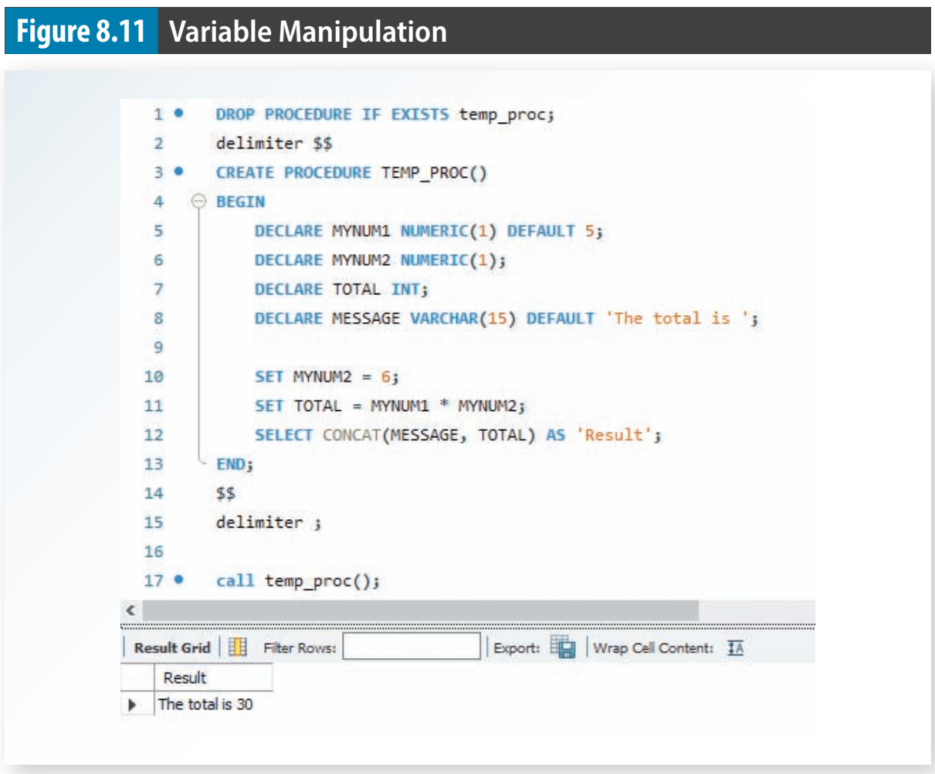

Slide 53
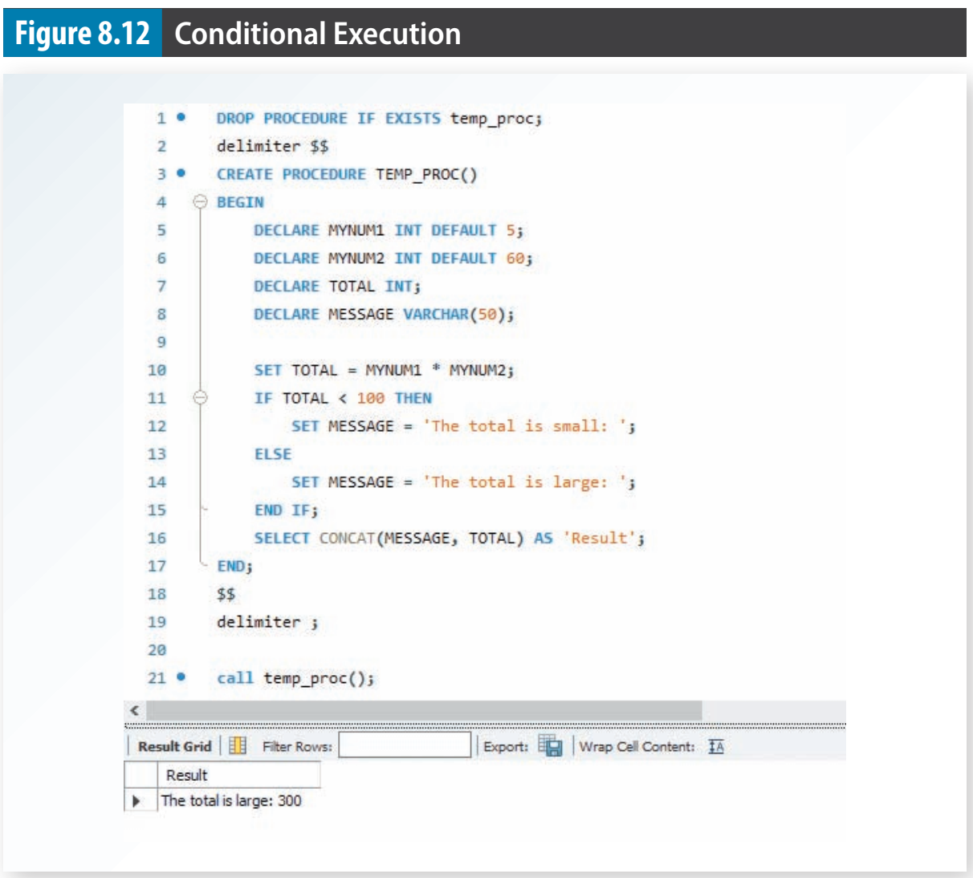

Slide 54
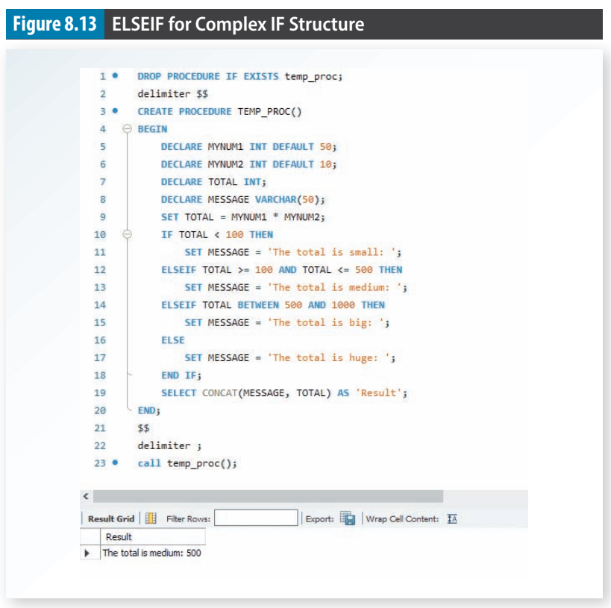

Slide 55
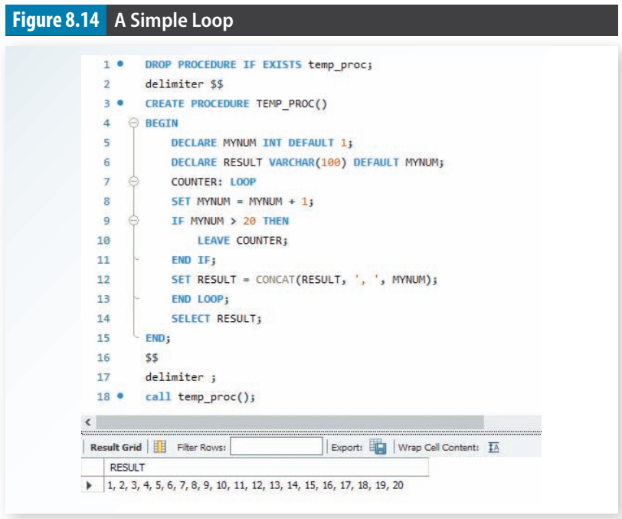

Slide 56
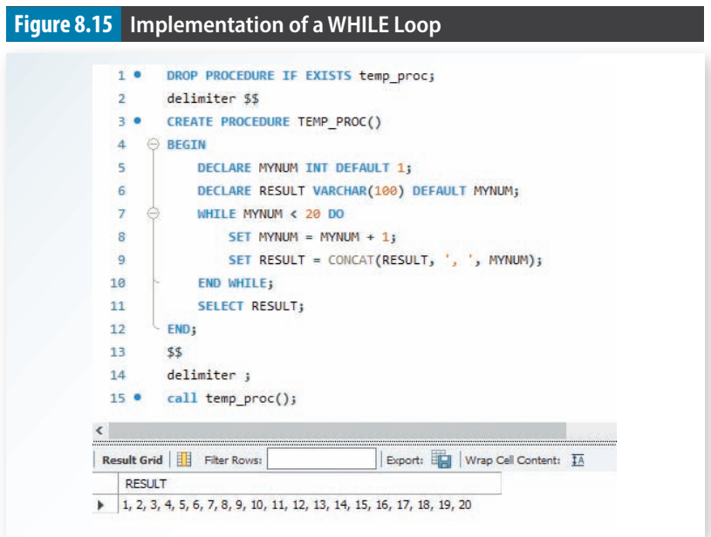

Slide 57
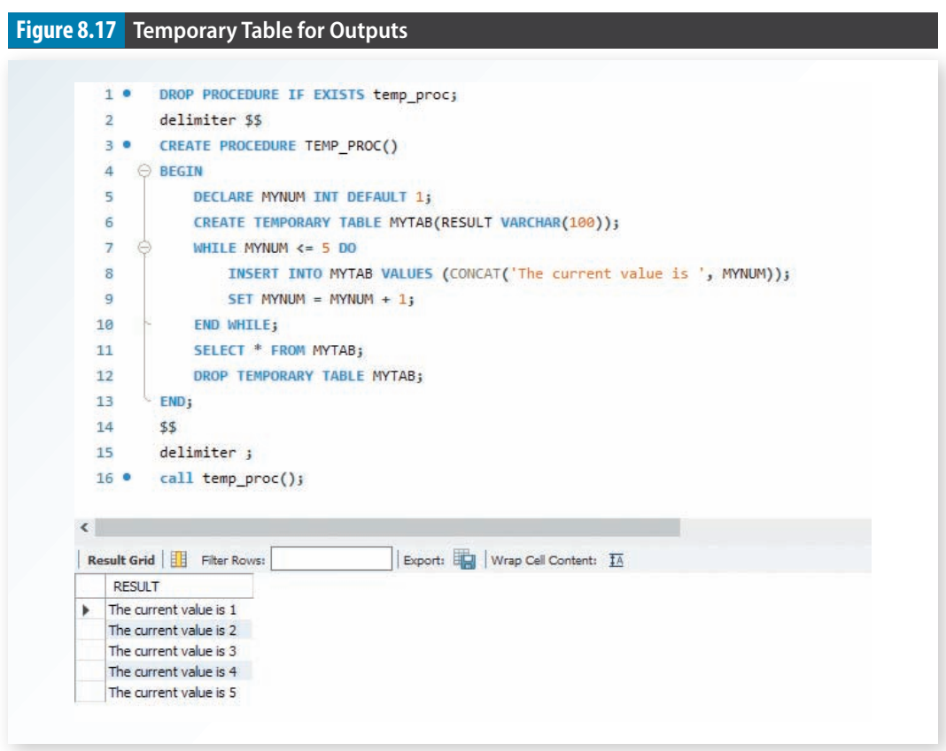

Slide 58
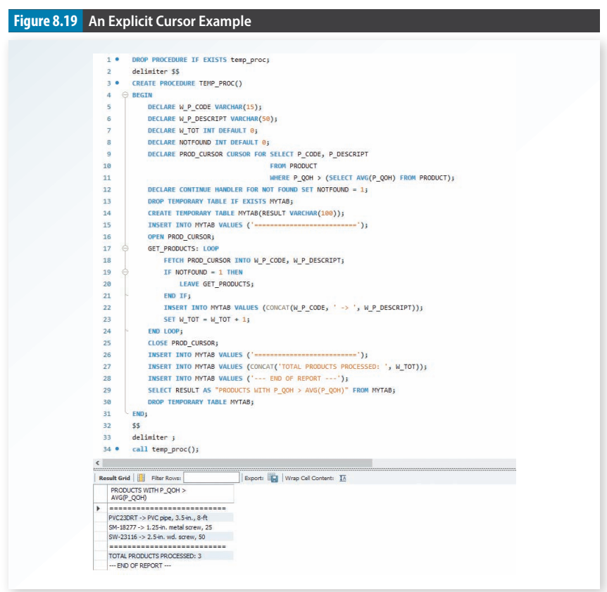

Slide 59
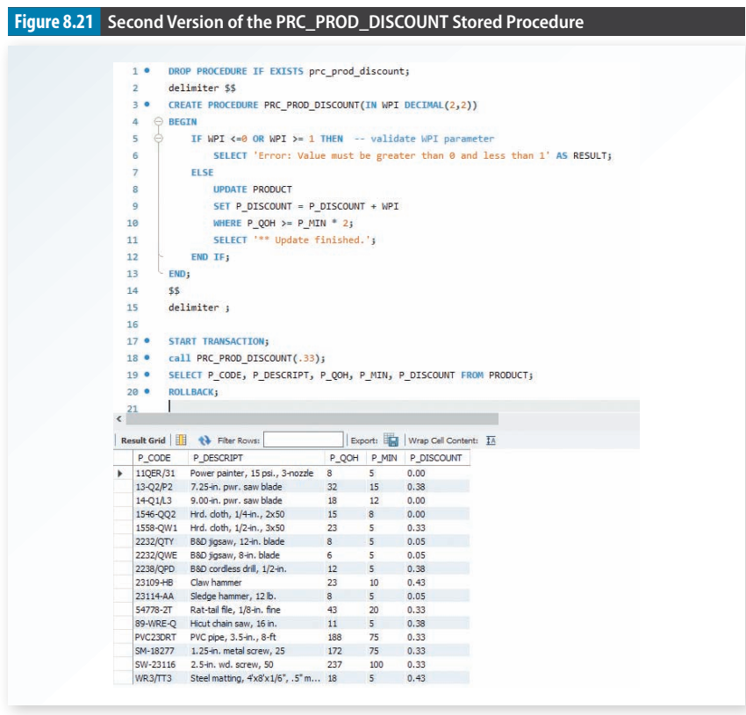

Slide 60
8-7g Triggers
Trigger A procedural SQL code that is automatically invoked by the relational database management system when a data manipulation event occurs.
A trigger is invoked before or after a data row is inserted, updated, or deleted.
A trigger is associated with a database table.
Each database table may have one or more triggers.
A trigger is executed as part of the transaction that triggered it

Slide 61
8-7g Triggers (cont.)
For example, if a product’s quantity on hand is updated when the product is sold, the system should automatically check whether the quantity on hand falls below its minimum allowable quantity.
To demonstrate that process, use the PRODUCT table in Figure 8.22. Note the use of the minimum quantity (P_MIN) and product reorder flag (P_REORDER) columns.
The P_MIN indicates the minimum quantity on hand allowable before restocking an item.
The P_REORDER column is a numeric field that indicates whether the product needs to be reordered (1 - Yes, - 5 No).
The initial P_REORDER values are set to 0 (No) to serve as the basis for the initial trigger development.

Slide 62
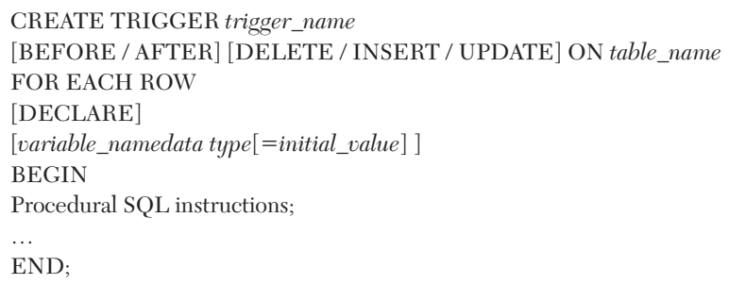

Slide 63
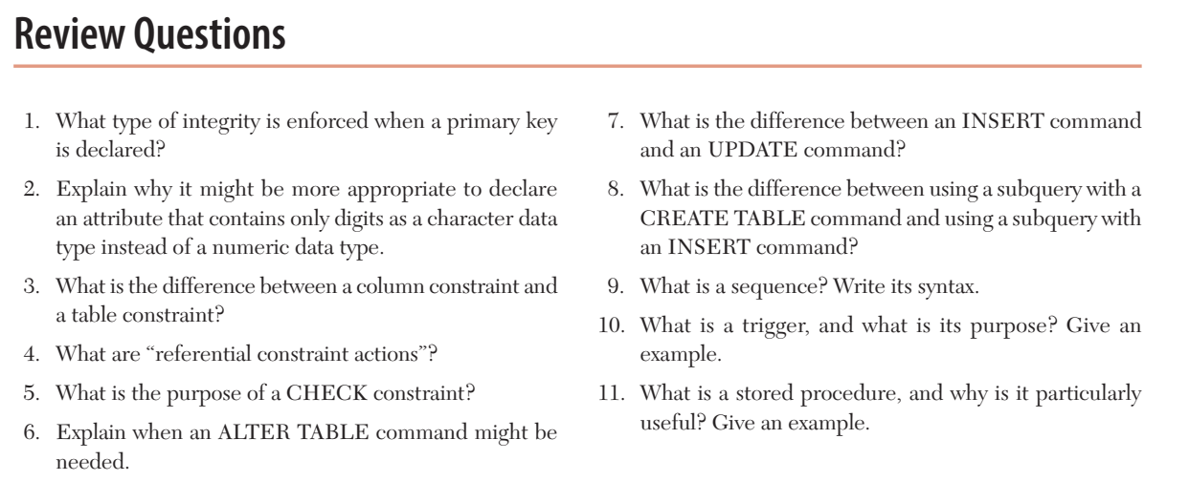

Slide 64
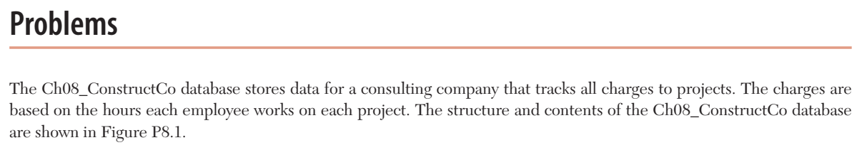

Slide 65
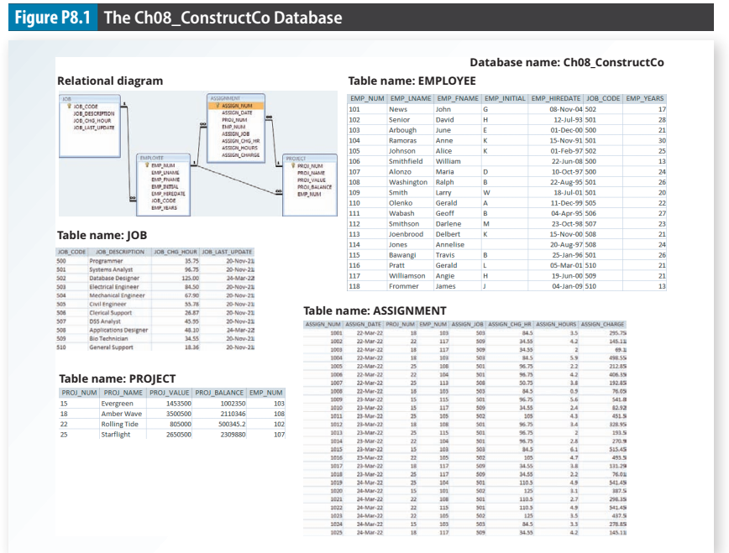

Slide 66
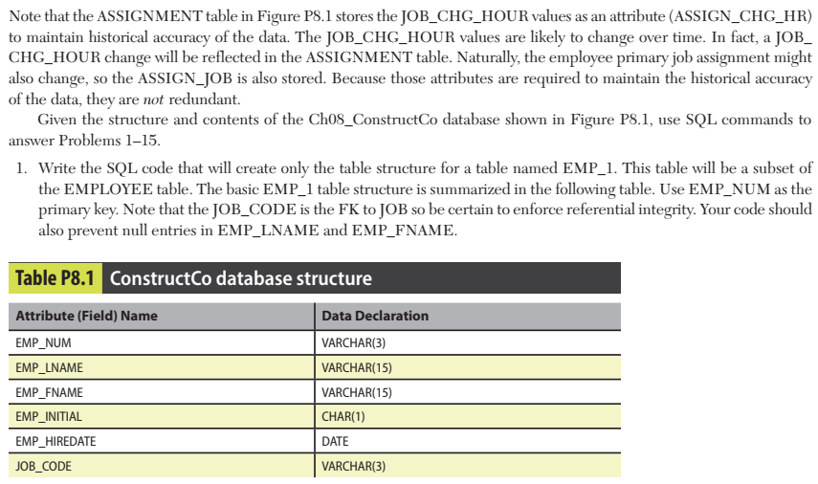

Slide 67


Slide 68


Slide 69


Slide 70


Slide 71


Slide 72


Slide 73


Slide 74


Slide 75


Slide 76


Slide 77


